Slide 1
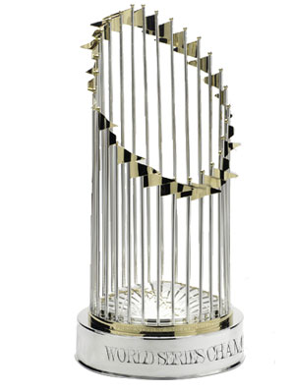

Using Statistics To predict playoff appearances
PREDICTIVE MODELING for Data Science 5K
Dan Russo
October 5, 2017

Slide 2

A History of Statistics in Baseball
America’s pastime was first played in 1839. Data was kept starting in 1859.
For the first century or so after statistics were kept, only simple analysis was conducted. But starting in the 1970s and coinciding with the advent of computers, Sabermetrics – the analysis of baseball statistics – has grown at an exponential rate.
Now all 30 teams and hundreds of websites and businesses employ data scientists to analyze baseball statistics.
“[Players] are overlooked for a variety of biased reasons and perceived flaws. Age, appearance, personality…mathematics cut straight through that.”

Slide 3
A few key statistics can be used to predict if a team will make the playoffs.
Hypothesis
Problem Statement
Can standard pitching, hitting, fielding, and baserunning statistics predict how many wins a team will have and if a team will make the playoffs?
Process
Obtain dataset from Kaggle.
Clean and combine data, create additional statistics.
Build predictive model.
Notes:
Data set seemed to be the most comprehensive. It had 24 different tables with data dating back to 1871.

Slide 4
Statistics Analyzed
Statistic | Category
Wins | Team
Home Runs | Offense
Earned Run Average (ERA) | Pitching
Strike Outs | Offense
Stolen Bases | Base Running
Home Runs Allowed | Pitching
Strike Outs Against | Pitching
Walk and Hits plus Innings Pitched (WHIP) | Pitching
Errors | Fielding
On Base Percentage (OBP) | Offense
Slugging | Offense
On Base Plus Slugging (OPS) | Offense
Salary | Team
Attendance | Team
After preparing the data and reducing the dataset to teams from 1985 – 2015 (888 records) I selected statistics that represented all aspects of the game and I thought would be good predictors of wins.

Slide 5
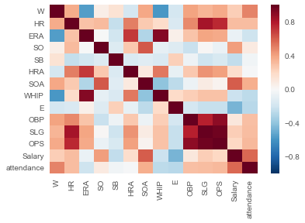
Data Correlation

Slide 6
Linear Regression Model
Ran two linear regression models with slightly different statistics to predict Wins.
Model 1: OPS, Home Runs, Strike Outs Against, Salary
Model 2: WHIP, OPS, SB, Strike Outs Against, Errors
Ran sklearn linear regression model with five fold cross-validation.
Takeaway: I could develop a model that explained 70% of wins. Not bad, but not good enough to be useful for a team.
Model | Mean MSE | Mean R²
Model 1 | 101.4 | 43,44
Model 2 | 43 | .697

Slide 7
Predicting Playoff Teams
Next I used a K-nearest neighbor model to see if I could predict which teams would make the playoffs.
I created a new data field to capture if the team made the playoffs. Then using, the variables from model 2, predicted if a team would make the playoffs using the sklearn knneighbors classifier model.
Takeaway: The optimum model complexity barely outperformed the null prediction (every team misses the playoffs).
Notes:
Additional, more complex metrics are needed to predict what type of players should be targeted to build a winning team.

Slide 8
Discussion

